Slide 1
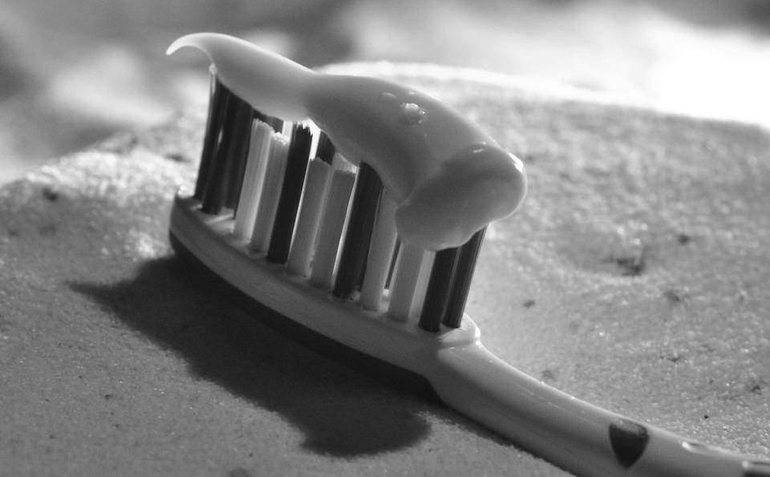
You have been asked to design a new brand of toothpaste. What would you include in the recipe for this toothpaste?
Toothpaste requirements:
1) It must have a pleasant flavour.
2) It must have a pleasant texture.
3) It must make your mouth smell nice.
4) It must contain fluoride (the ingredient that fights plaque).
5) It must not contain any harmful ingredients.
Name of toothpaste:

Slide 2
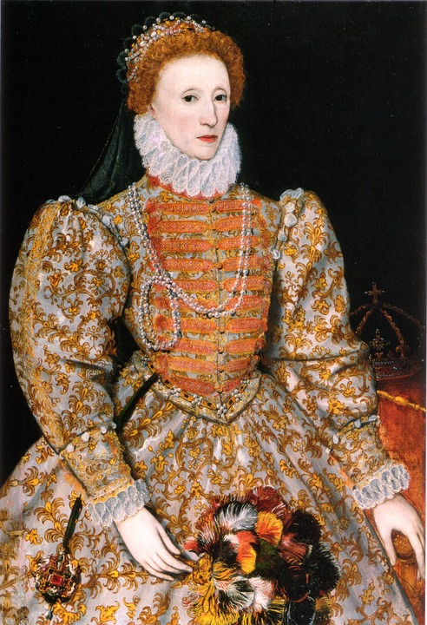
Using polite persuasion (It wouldn’t be wise to cause offence!), write a short letter to
Queen Elizabeth I. In your letter, you will need to explain why her sugary toothpaste is
causing more harm than good to the state of her teeth and gums. Perhaps you could
suggest an alternative? Don’t forget to use flattery. This queen was renowned her vanity!

Slide 3
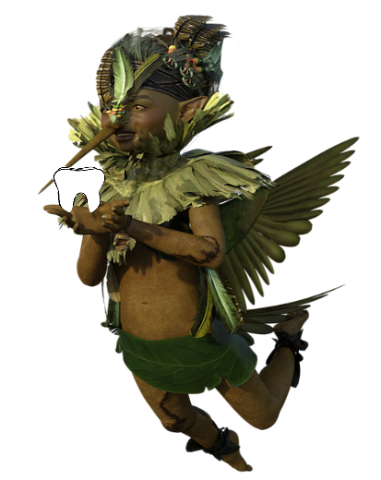
Can you write a short letter from the tooth fairy?
Dear Arthur,
Thank you for leaving me such a lovely snow-white tooth. I am looking forward to receiving the next one and I hope that it will be just as clean!
Keep brushing,
The tooth fairy xxx
P.S. Don’t spend the money on too many sweets. They can lead to tooth decay and a black tooth would look really out of place in the wall of my fairy palace!

Slide 4
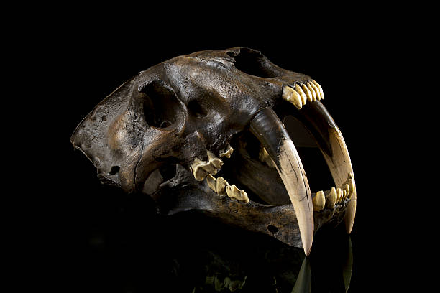
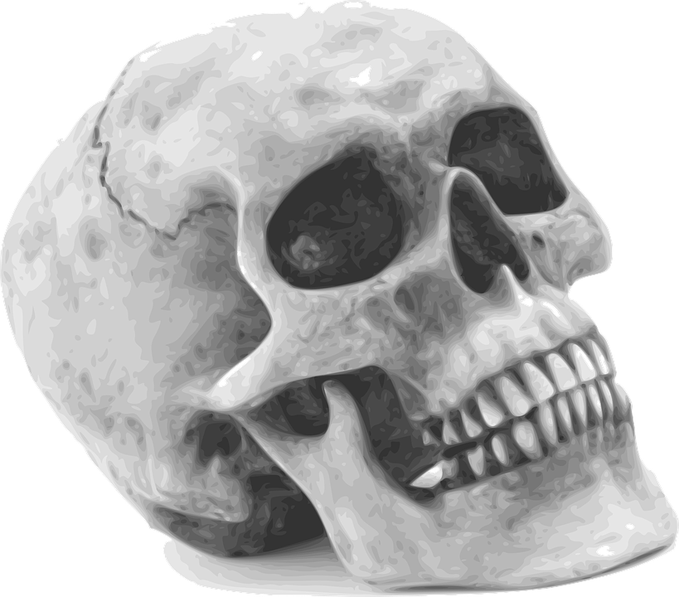
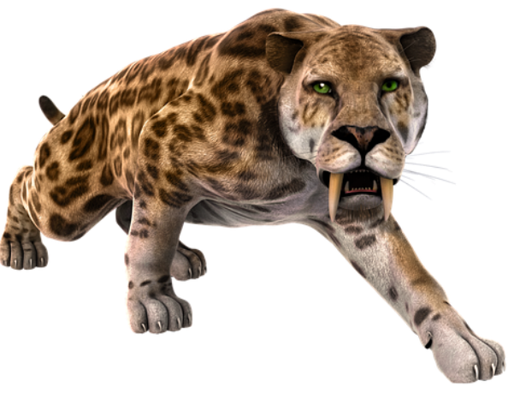
What are the similarities and differences between the skull of a human and the skull of a sabre-toothed cat?
Long after the dinosaurs died out, the saber-toothed cats became the top predator of the prehistoric world. These mammals are named for their long, swordlike canine teeth.
Similar | Different
Both skulls belong to mammals. ? | The eye sockets in a human skull are forward facing. ?

Slide 5
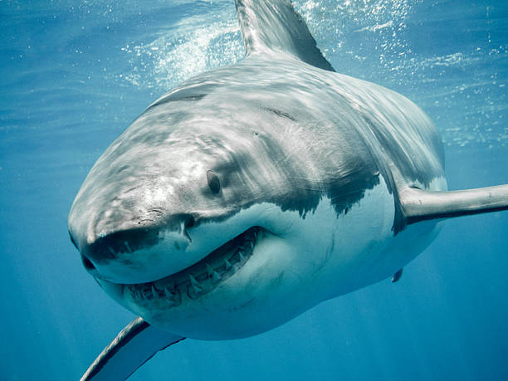
Did you know?
Unlike human teeth, shark teeth do not have roots. This means that they fall out easily when a shark is eating. However, this isn’t a problem for a shark as it can simply replace lost teeth with new ones from a different row. With teeth growing all the time, a shark can get through tens of thousands of teeth in its life-time.
Beryl, the great white shark, was 50 years old.
Every week of her life, she lost an average of 4 teeth.
How many teeth had Beryl lost in her life-time?
Extension Challenge
If this rate of tooth loss continued, how many teeth would Beryl have lost by the time she reached the age of 70?

