Slide 1
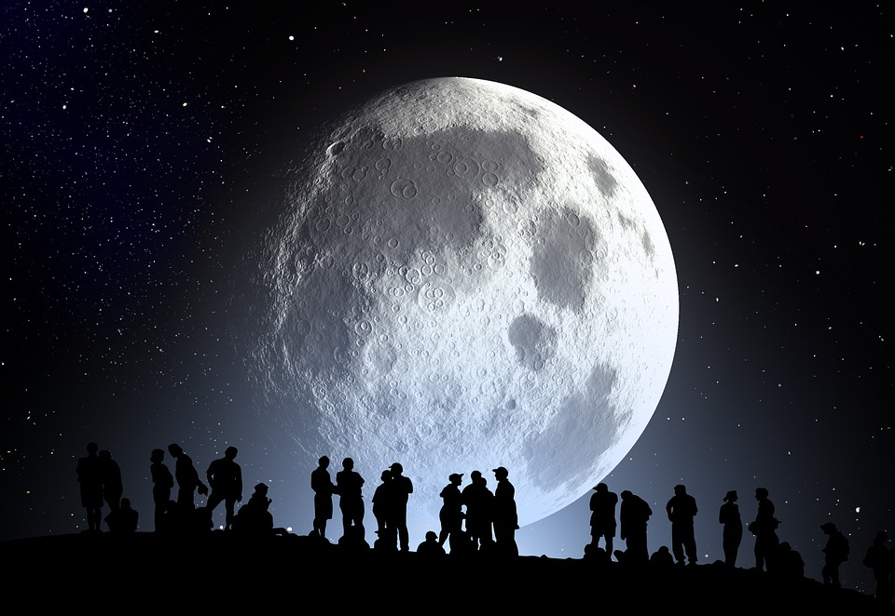
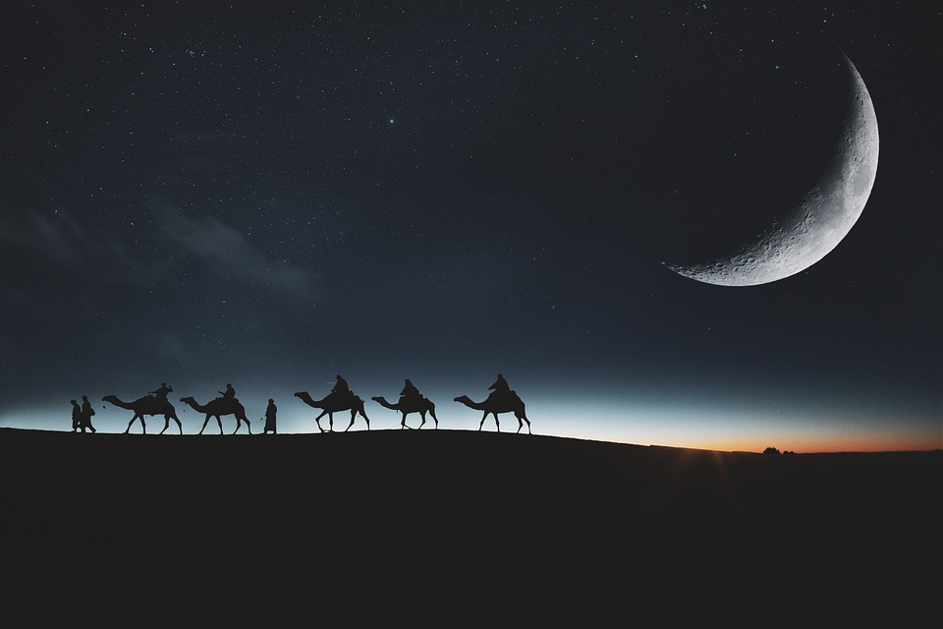
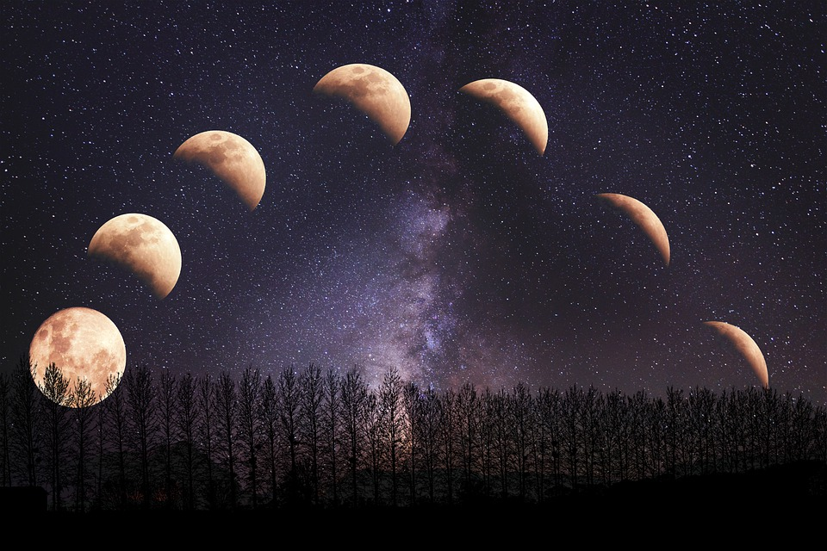
Can you write some Moon metaphors?
The Moon is a ghostly galleon, sailing on a black sea.
The Moon is a reliable friend, who guides me safely home.
The Moon is a glitter ball, hanging in a vast nightclub.
The Moon is a chameleon with many different faces.

Slide 2
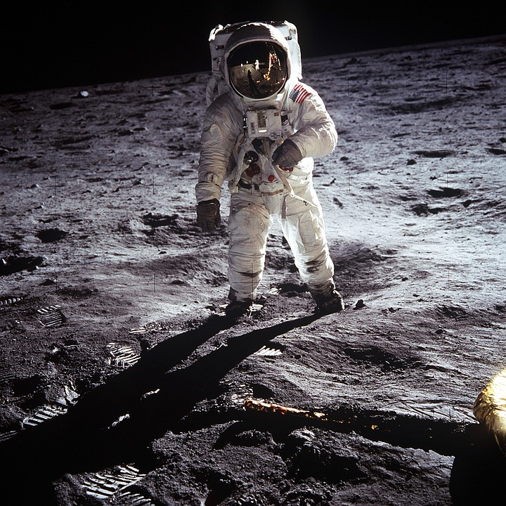
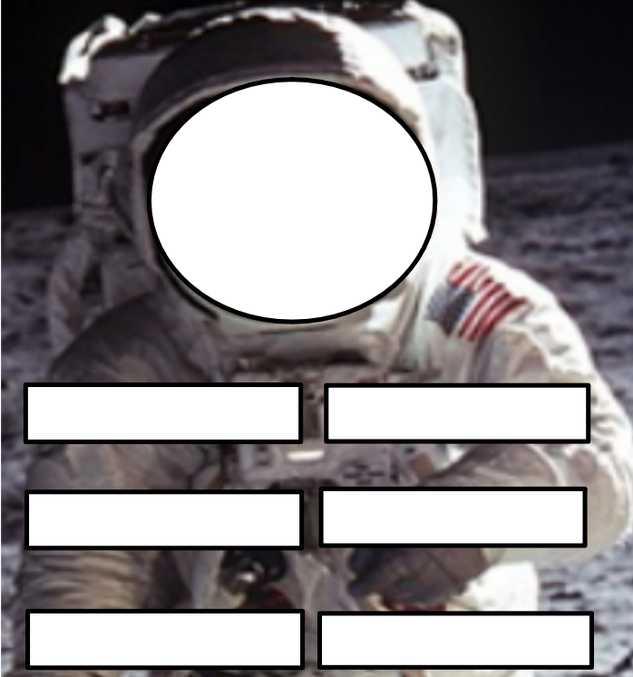
If you could see the expression on Buzz Aldrin’s face, what would it look like?
Can you think of 6 words that capture how Buzz might be feeling?
This photograph shows the American astronaut, Buzz Aldrin, on the surface of the Moon. It was taken by mission commander Neil Armstrong. The two men were the first humans to walk on the Moon as part of the 1969 Apollo 11 mission.

Slide 3
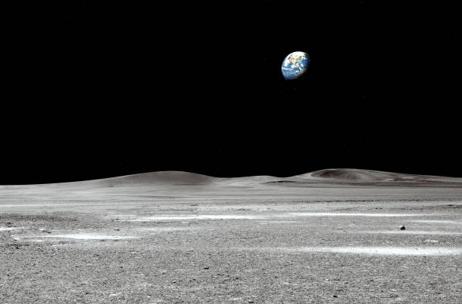
A lunar rover or moon rover is a space exploration vehicle designed to move across the surface of the Moon. Having read design requirements below, have a go at drawing your own fully autonomous lunar rover. Annotate your design so that its features are clear.
Design requirements of lunar rover:
1) It needs to be powered by a renewable energy source.
2) It needs to be able to travel across a rocky and uneven surface.
3) It must be able to take rock samples.
4) It must be able to take pictures of the Moon’s surface.
5) It must be able to withstand temperature extremes.
Name of lunar rover:

Slide 4
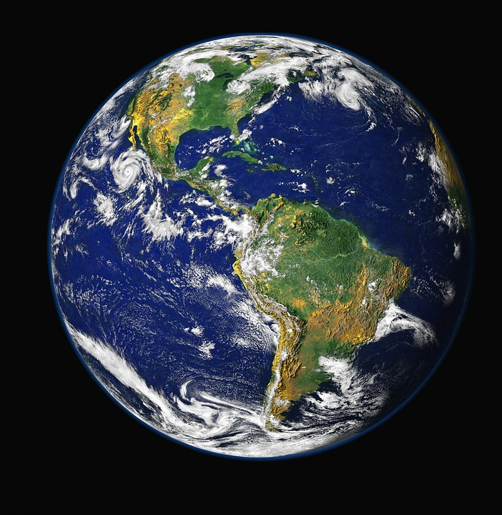
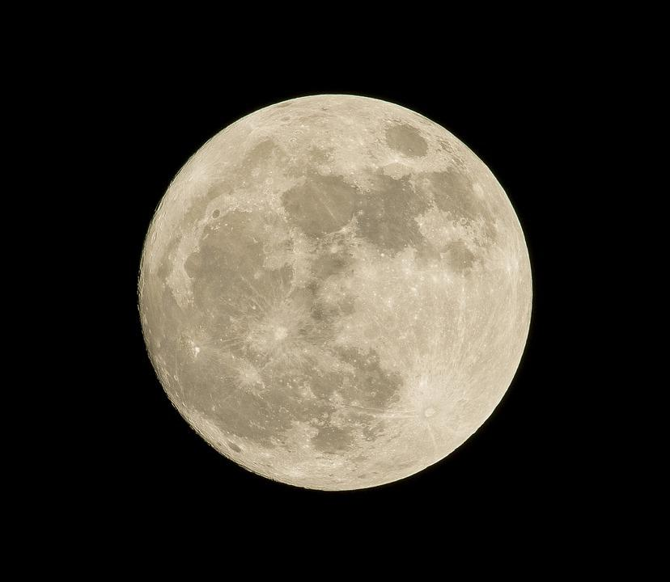
Can you use your knowledge of size and fractions to make your own comparison statements about things you can see in your classroom?
The Moon is a bit more than a quarter the size of Earth.
Examples:
Alfie’s ukulele is a third the size of Lorna’s guitar.
The cheese plant is twice as tall as
the spider plant.

