Slide 1
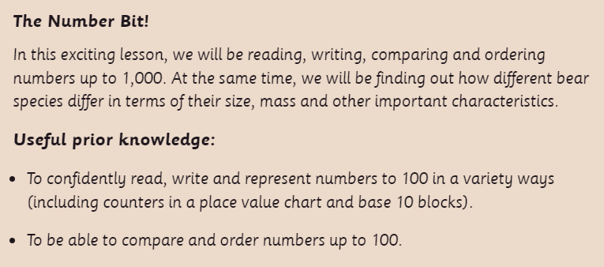
This lesson is best viewed as a slide show, using the PowerPoint annotation pen.

Slide 2
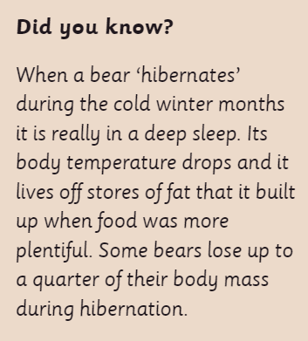

Slide 4
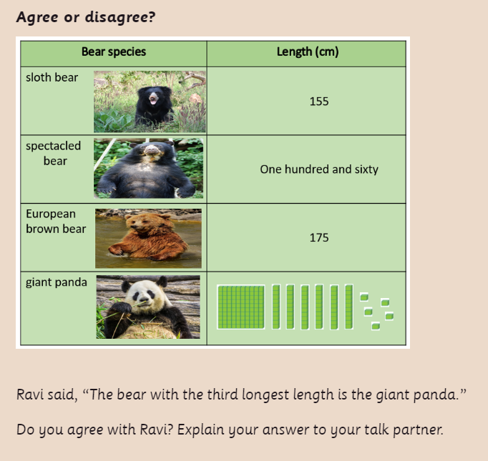

Slide 5
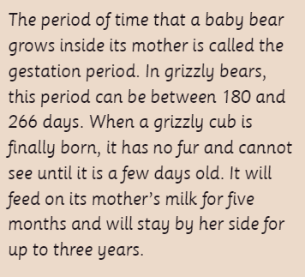

Slide 6
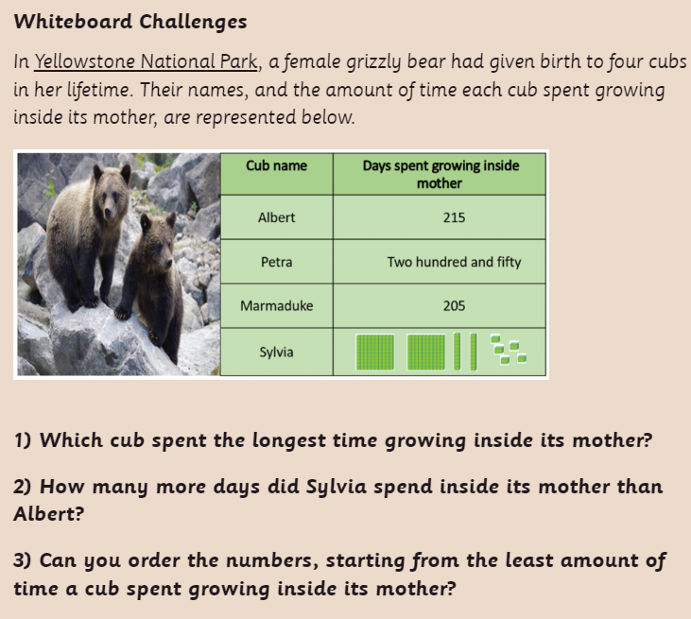

Slide 7
Now have a go at the worksheet.

Slide 8
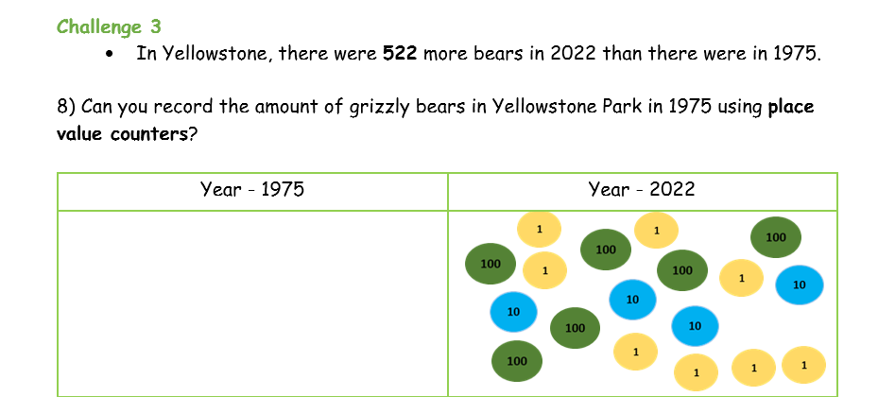
Plenary: Challenge 3 from the worksheet.

